Slide 1
Humility

Slide 2
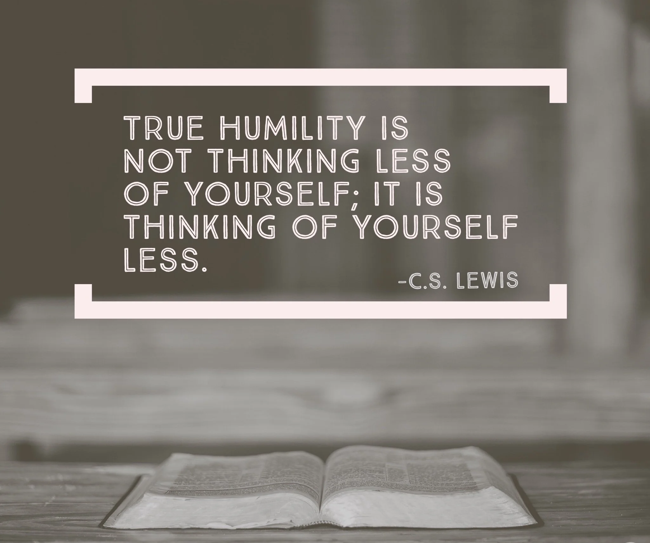

Slide 3
Proverbs 22 v4
Humility is the fear of the Lord; its wages are riches and honor and life.

Slide 4
The greatest commandment [Matthew 22 v 36-40]
[The Pharisees/Sadducees were testing Jesus] … “Teacher, which is the greatest commandment in the Law?” Jesus replied: “‘Love the Lord your God with all your heart and with all your soul and with all your mind.’ This is the first and greatest commandment. And the second is like it: ‘Love your neighbor as yourself.’

Slide 5
Where humility/humble appears in the bible
Notes:
66 references (72.5%) in the Old testament
25 references (27.5%) in the New testament

Slide 6
2 Chronicles 1 v 7-10
That night God appeared to Solomon and said to him, “Ask for whatever you want me to give you.”
Solomon answered God, “You have shown great kindness to David my father and have made me king in his place. Now, Lord God, let your promise to my father David be confirmed, for you have made me king over a people who are as numerous as the dust of the earth. Give me wisdom and knowledge, that I may lead this people, for who is able to govern this great people of yours?”

Slide 7
2 Chronicles 1 v 11-12
God said to Solomon, “Since this is your heart’s desire and you have not asked for wealth, possessions or honor, nor for the death of your enemies, and since you have not asked for a long life but for wisdom and knowledge to govern my people over whom I have made you king, therefore wisdom and knowledge will be given you. And I will also give you wealth, possessions and honor, such as no king who was before you ever had and none after you will have.”

Slide 8
Psalm 149 v 4
For the Lord takes delight in his people; he crowns the humble with victory.

Slide 9
Isaiah 45 v 23
By myself I have sworn, my mouth has uttered in all integrity a word that will not be revoked: Before me every knee will bow; by me every tongue will swear.

Slide 10
James 3 v 13
Who is wise and understanding among you? Let them show it by their good life, by deeds done in the humility that comes from wisdom.

Slide 11
Where is God asking for your humility? The “anti -fruit”
Love | Undervalue
Joy | Anguish
Peace | Unrest
Patience | Defiance
Kindness | Interference
Goodness | Wickedness
Faithfulness | Disloyalty
Gentleness | Harshness
Self-control | Overindulgence
The fruit of the Spirit
The anti-fruit

